Slide 1
listen …

Slide 2
GES1011/GESS1009
The Evolution of a
Global City-State

Slide 3
recap ++
human conversations mainly about Singapore’s pasts, its present and its future within a global context …

Slide 4
recap ++*
given human subjectivity,
these conversations are,
more often than not,
open-ended and far from finality and resolution ...

Slide 5
recap ++
in the course of having these conversations, we will be imagining Singapore’s pasts …

Slide 6
recap ++
imagining what is now 1°09’N and 1°29’N, and, 103° 38’E and 104° 06’E’s past …

Slide 7
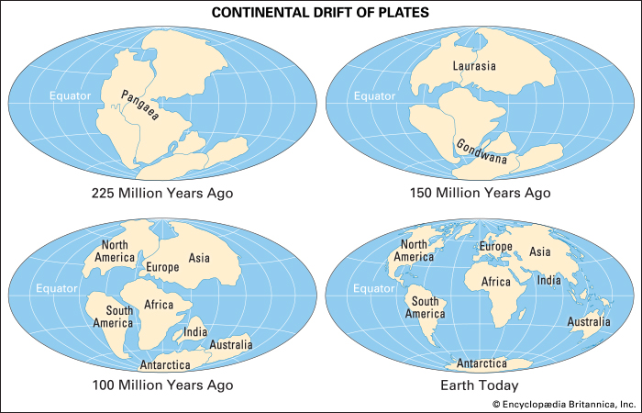
recap ++: a geological unfolding …

Slide 8
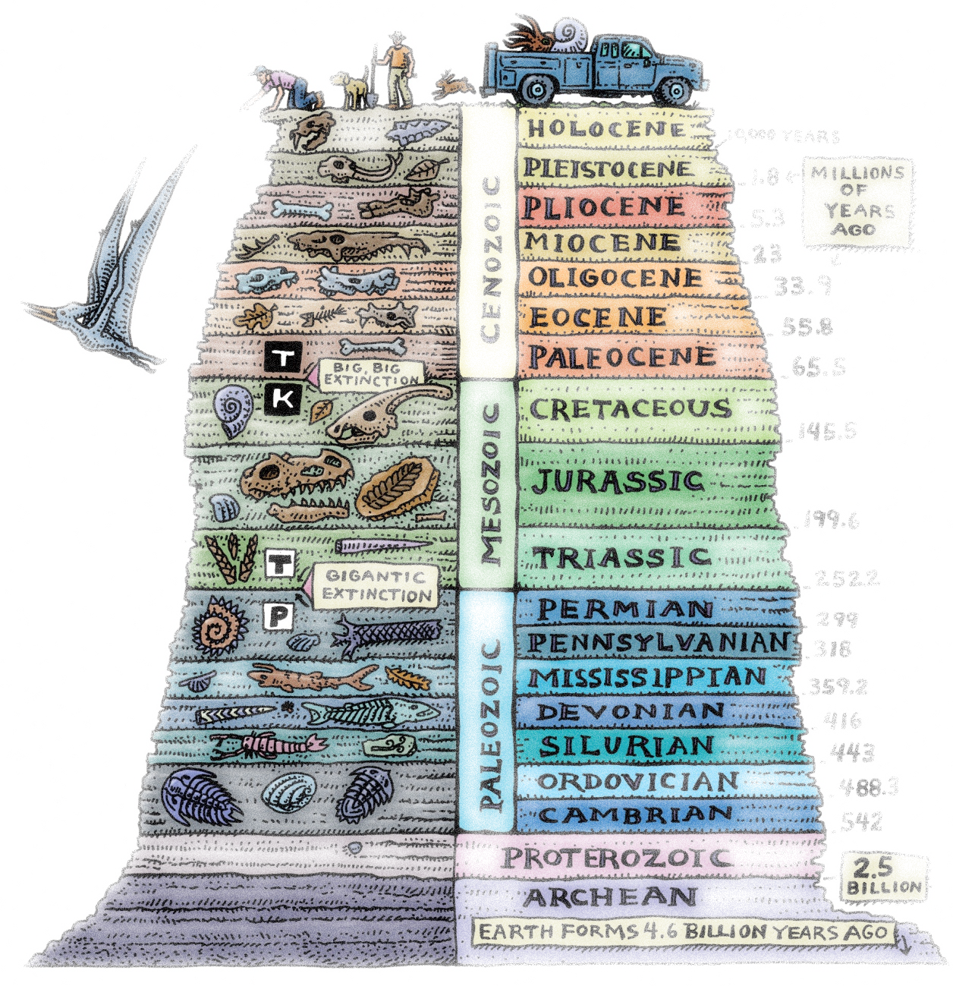

recap ++: a biological and human unfolding …

Slide 9
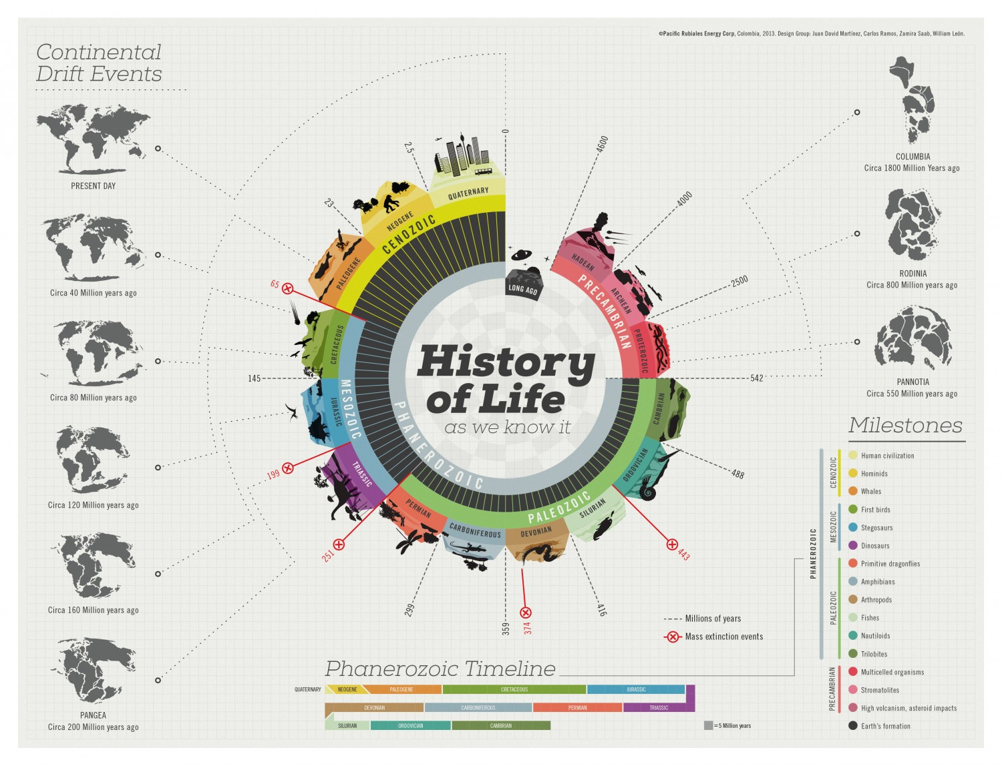
recap ++: a geological, biological and human-cultural unfolding …

Slide 10
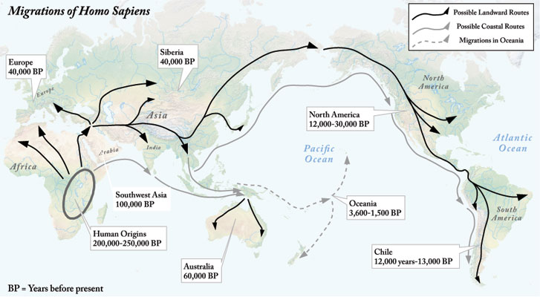
recap ++: a human unfolding …

Slide 11
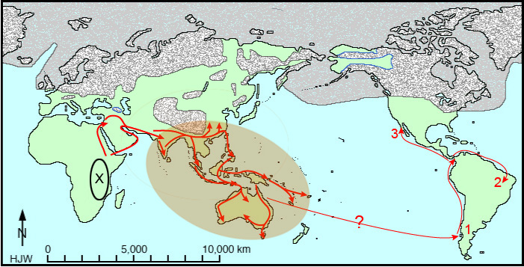
recap ++: a human unfolding …

Slide 12

in memoriam

Slide 13
in memoriam
‘the loneliest man in the world’
@ ‘the hole Indian’
@ ‘the man of the hole’
Born: est. 1962
Died: 22(?) August 2022

Slide 14

in memoriam

Slide 15
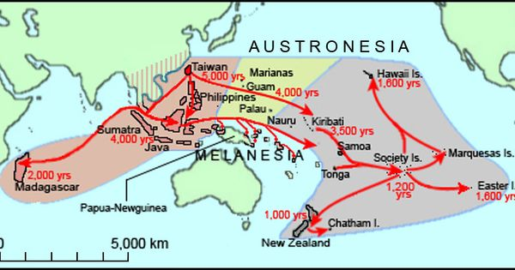
recap ++: a more recent regional human unfolding …

Slide 16
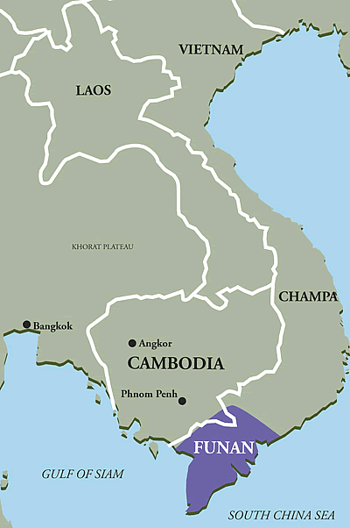
recap ++: forerunner of Singapura ?

Slide 17
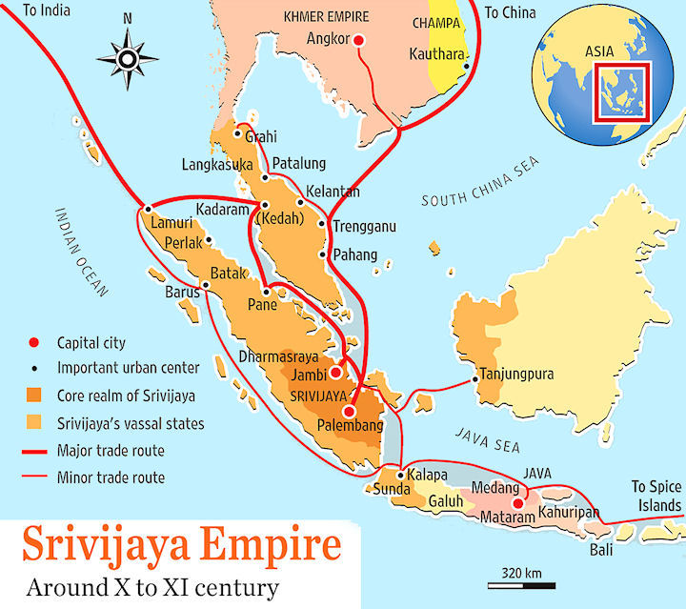
recap ++: forerunner of Singapura ?

Slide 18
recap ++: a regional human unfolding …
so, finally …
after several billion years of life on the planet …
and maybe 200,000 years of human movement/migration …
we have the first evidence of some human activity on what is now 1°09’N and 1°29’N, and, 103° 38’E and 104° 06’E …

Slide 19
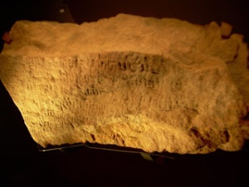
recap ++: a local manifestation

Slide 20
Question and Response

Slide 21
our task today …
making sense of a (seemingly relevant) written* source …
making sense of the Sulalat al-Salatin (assigned reading) …
perusing a second source (recent archaeological data) …
attempting to interpret Singapore’s past (beginnings?)…
learning two concepts commonly used in history …

Slide 22
Sulalat al-Salatin
tales/stories/myths …
of prowess …
of relationships …
of maritime travel …
linked closely to a genealogy ...
material and metaphysical dimensions …
sprinkled with issues of morality (good, evil, justice), love, beauty, achievements and accolades, conquests, ritual (lustration) and feasts …
not to forget puke (beast and ‘demon’) and its ingestion thereof …

Slide 23
Sulalat al-Salatin
history
story
fantasy
myth

Slide 24
Sulalat al-Salatin: would you use it in efforts to interpret Singapura’s past?
yes
no
unsure
depends

Slide 25
Sulalat al-Salatin
stories of some of its kings (total of five) …
the rise of this polity (Singapura) …
its wealth and fame …
its rivals ...
(misleadingly referred to as Malay Annals/Sejarah Melayu)

Slide 26
Sulalat al-Salatin
Temasek/Singapura …
what brought it to attention?
gleaming white sand …
like a piece of white cloth …
marks a/the ‘beginning’ for ‘Singapore’ ???

Slide 27
Sulalat al-Salatin
probably first written in the 17th century ...
‘written’ refers to oral accounts passed down from generation to generation which came to be recorded in a manuscript ...
written not to be silently read ...
but to be sung/chanted by the very few literate members of a pre-literate community for the latter’s listening pleasure ...
reading it silently and in translation significantly obscures (if not violates) the rhythmic and melodic quality of the language ...

Slide 28
interpreting the Sulalat al-Salatin
“no one has claimed the Malay Annals Sulalat is a reliable guide to dates or events. Scholars however debate the intriguing questions of how we can reconstruct the intentions of the compilers of the Malay Annals. To what extent was it meant to depict Singapura’s actual appearance and importance in the fourteenth century?” (Miksic, p. 154)

Slide 29
interpreting the Sulalat al-Salatin
no one has claimed the Sulalat is a reliable guide to dates or events …
scholars however debate the intriguing questions of how we can reconstruct the intentions of the compilers of the Malay Annals …
to what extent was it meant to depict Singapura’s actual appearance and importance in the fourteenth century?

Slide 30
interpreting the Sulalat al-Salatin
Miksic’s comments quite neatly encapsulate some of the factors involved when it comes to interpretive work …
who wrote it?
when was it written?
who was/were its intended audience/s?

Slide 31
interpreting the Sulalat al-Salatin
the responses to these questions are far from easily forthcoming …
and evidence of a good/meaningful general education lies in realising/appreciating this situation (complex) …
and being able articulate your best interpretation …
not so much resolving it with any degree of finality …

Slide 32
interpreting the Sulalat al-Salatin
a lack of easy answers (complexities) mark human existence (past and present) …
and in responding to them …
we need to learn to be comfortable with some ambiguity and uncertainty …
embark on a learning journey that spurns easy answers
but embraces carefully qualified responses …

Slide 33
Sulalat al-Salatin: would you use it in efforts to interpret Singapura’s past?
yes
no
unsure
depends

Slide 34
Question and Response

Slide 35
the archaeological record …
for a long time, with only oral/textual sources speaking to Temasek/Singapura’s pasts …
(Sulalat was one of a few textual sources, there were some Chinese sources and some other Southeast and South Asian sources)
it was difficult to be confident about the historicity of Singapura/Singapore before the 1800s …
then there was Miksic …

Slide 36
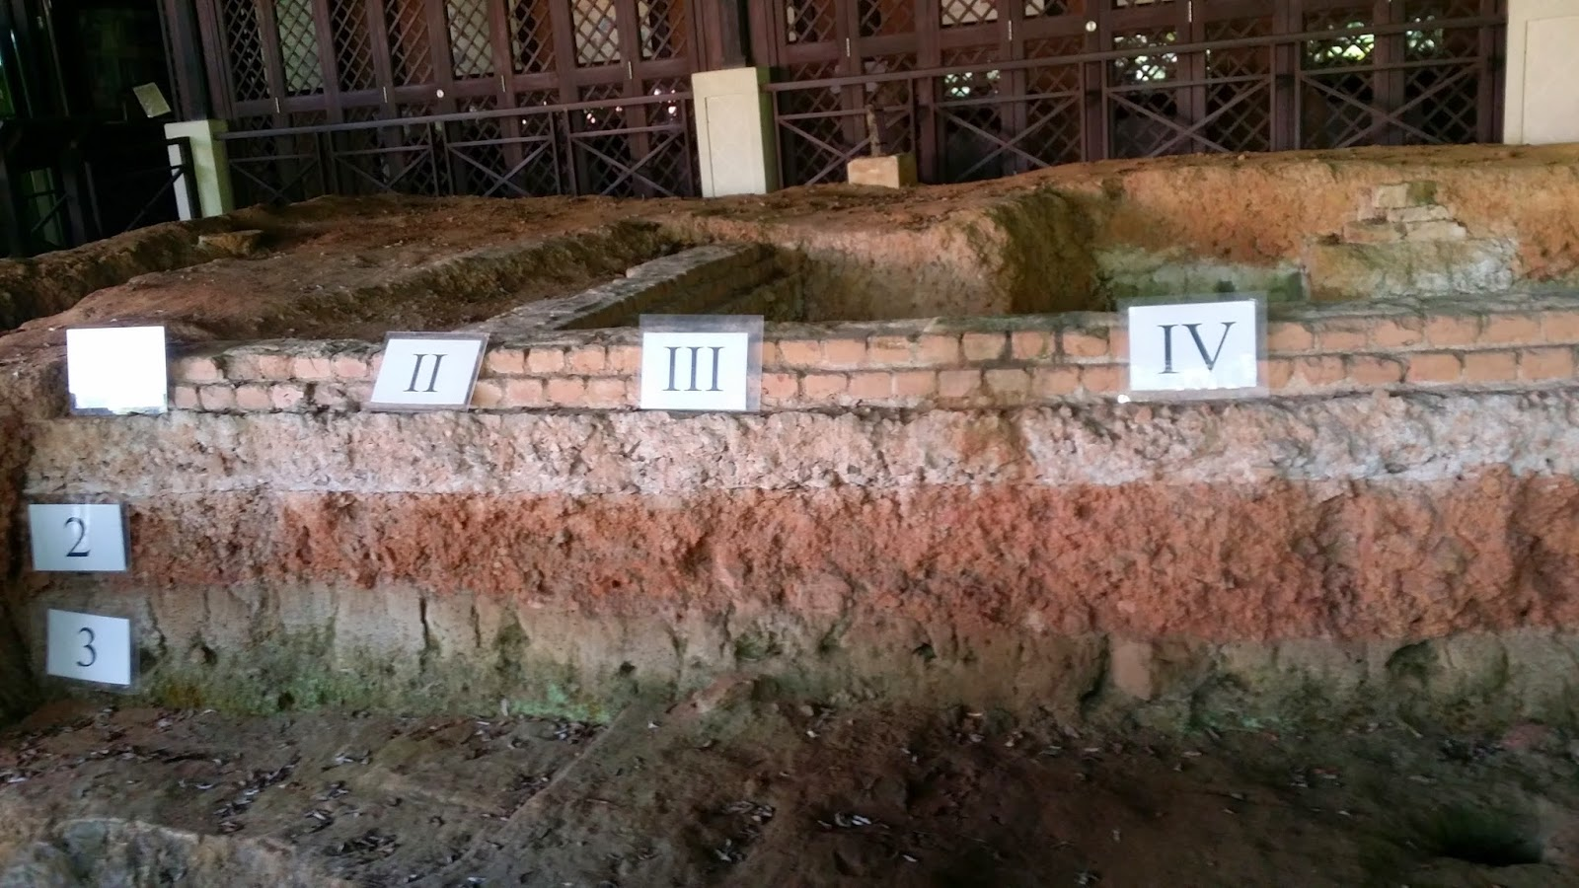

Slide 37
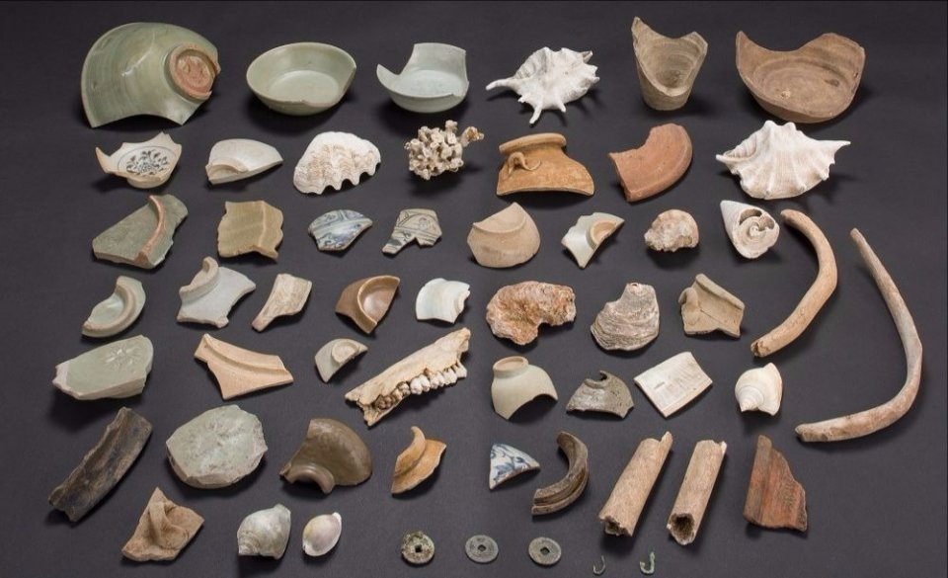

Slide 38
the archaeological record …
in Tutorial 2, we will e-visit the archeological site and view the artefacts for ourselves …
for more details, read the Miksic reading assigned for today …

Slide 39
the archaeological record …
the archaeological evidence …
makes it difficult to doubt human activity on what is now 1°09’N and 1°29’N, and, 103° 38’E and 104° 06’E …
in the 14th century …

Slide 40
Question and Response

Slide 41
corroboration …
according to Miksic, there is a layer of white sand below the Padang …
stretching from the Singapore river to Kampung Gelam ..
corroboration: independent evidence

Slide 42
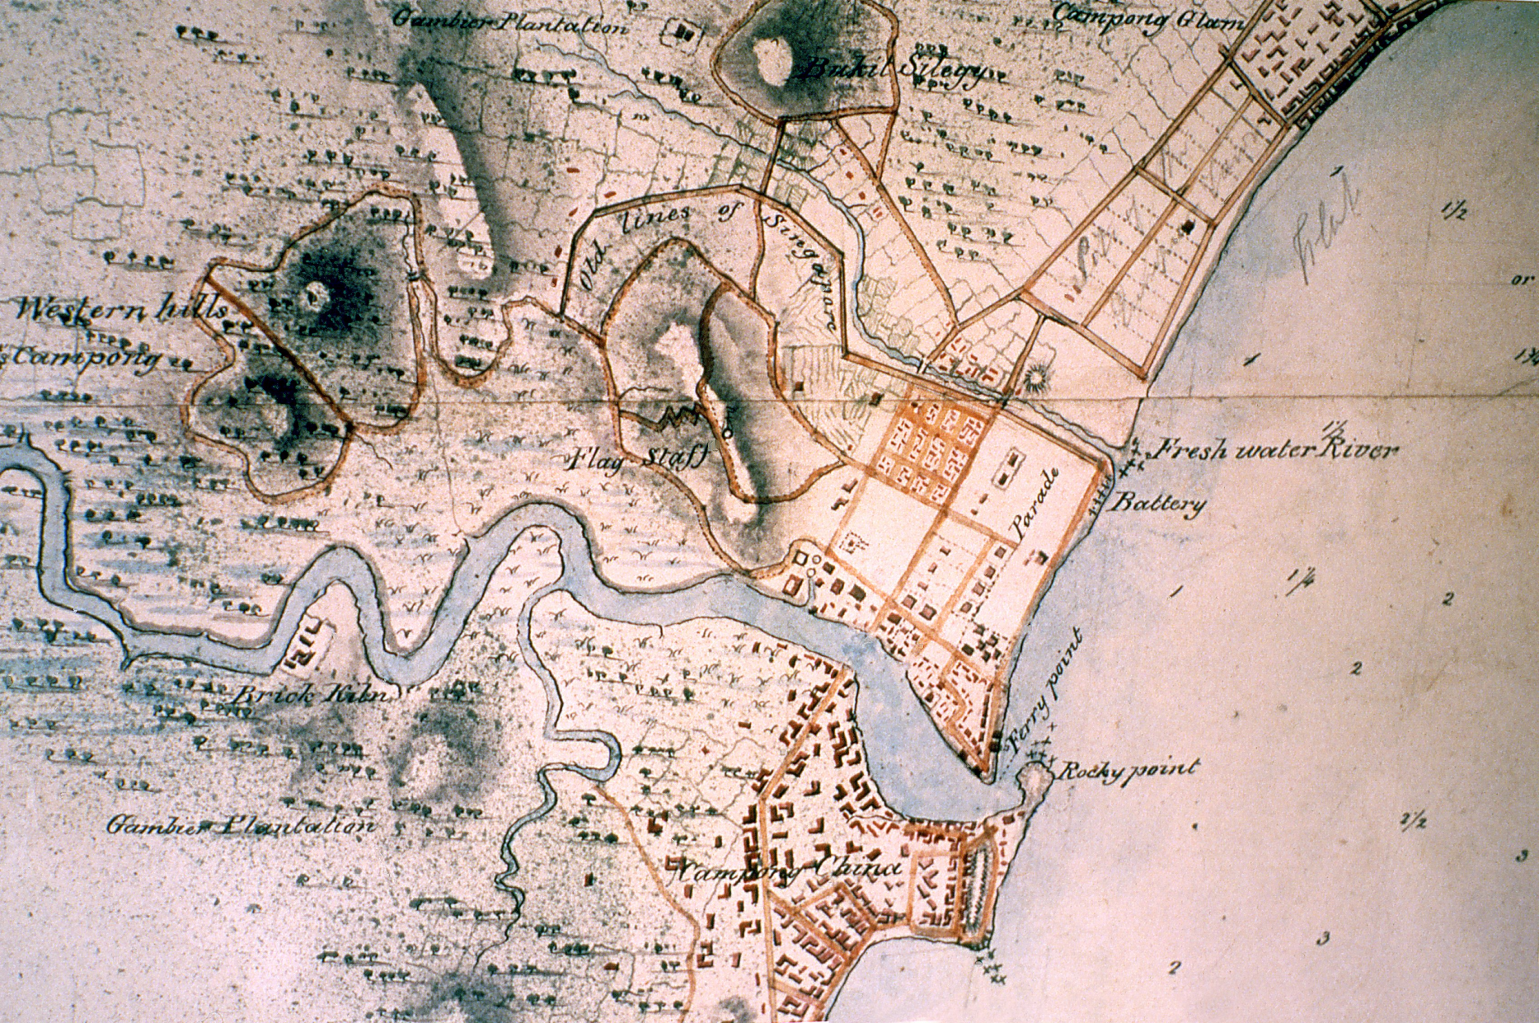
corroboration …

Slide 43
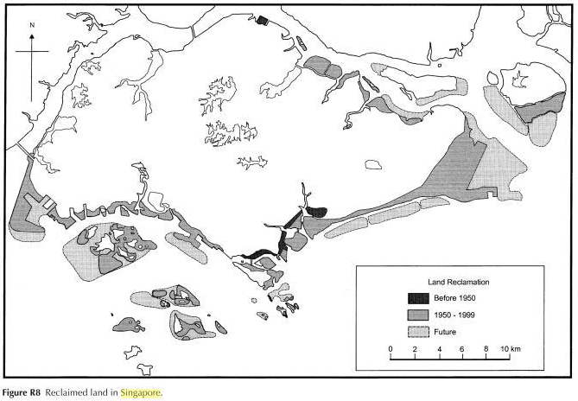

Slide 44
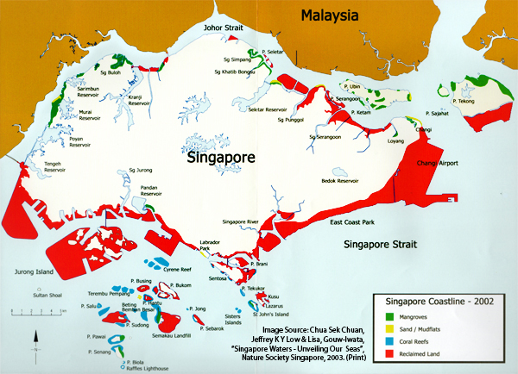

Slide 45
corroboration …
physical evidence relating to human activity between 1°09’N and 1°29’N, and, 103° 38’E and 104° 06’E ...
700 years ago …
suggests a not insignificant population at that point in time?
offers corroboration for information in the Sulalat?

Slide 46
does Miksic’s discovery of White Sand make you more open to using information in the Sulalat?
yes
no
maybe

Slide 47
watch …
does this ceremony make you more open to using the Sulalat as a historical source?

Slide 48
does the perpetuation of such practices in present day Malaysia make you more open to using information in the Sulalat?
yes
no
maybe

Slide 49
corroboration …
the archaeological record, impressive as it may be ...
does NOT speak for itself …
you still need other sources to read alongside such materials …
one of which, is the Sulalat …

Slide 50
Question and Response

Slide 51
interpreting Singapore’s past …
based on two sets of sources ...
very different sources ...
human activity on this island does stretch back at least 700 years …

Slide 52
is this past, particularly the 14th century, part of Singapore’s story?
yes
no
depends

Slide 53
is this past, particularly the 14th century, part of the Republic of Singapore’s story?
yes
no
depends

Slide 54
does Singapura have anything to do with Singapore?
yes
no
hmm ..

Slide 55
interpreting Singapore’s past …
what then of Kwa, Heng and Tan’s efforts in writing ‘A 700 year history of Singapore’?
would you advise them differently?
why? or why not?

Slide 56
interpreting Singapore’s past …
if there is substantive disagreement with them about their “extension of Singapore’s story” …
in history, we call this a historiographical disagreement or difference …
do realise that it is quite difficult to resolve/reconcile these types of disagreements …

Slide 57
some concepts to note …
a historiographical difference that has emerged in this module?
Turnbull’s(Lee 1997) understanding of Singapore’s past (it begins in 1819)…
and of course, Miksic’s take (in the 14th century)…

Slide 58
historiographical difference
Turnbull (Lee 1997)
Miksic
human activity since 1819 …
sources: colonial documents
dominant since 1960s …
links Singapore to the outside (Britain)
human activity since 14th century …
sources: archaeological, literary (Sulalat) and some others (Chinese)…
emerged between mid-1980s and 1997 …
links Singapore to the outside (regional and transoceanic*)

Slide 59
Question and Response

Slide 60
think …
what have we learned about human activity on what is now 1°09’N and 1°29’N, and, 103° 38’E and 104° 06’E …?
does it challenge received interpretations of Singapore’s past?
how significantly?

Slide 61
Tutorial 2 Registration & Attendance

Slide 62
Question and Response

